Slide 1





Ibm data science
Final project
Supervised by
Ass. Prof Yasmine Elhamouly
Supervised by
Ass. Prof Yasmine Elhamouly
Mariam Mahmoud
Yahia Mohamed

Slide 2

CONTENT
Presented to you by:
Ahmed
ehab
Omar
gamal
Farah
tamer
Mariam omran
Madline
raafat

Slide 3



Presented to you by
CONTENT
1
2
3
4
5
6
Application set up
User interface
Data management
Prediction pipeline
Deployement & closing
Results of
model
I
Dean of Faculty of Dentistry
Pharos University in Alexandria

Slide 4


CLEANING

Slide 5
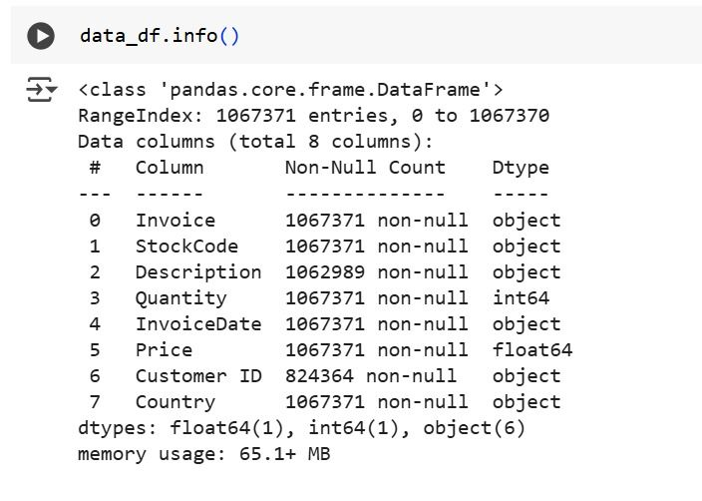
BEFORE CLEANING
I

Slide 6
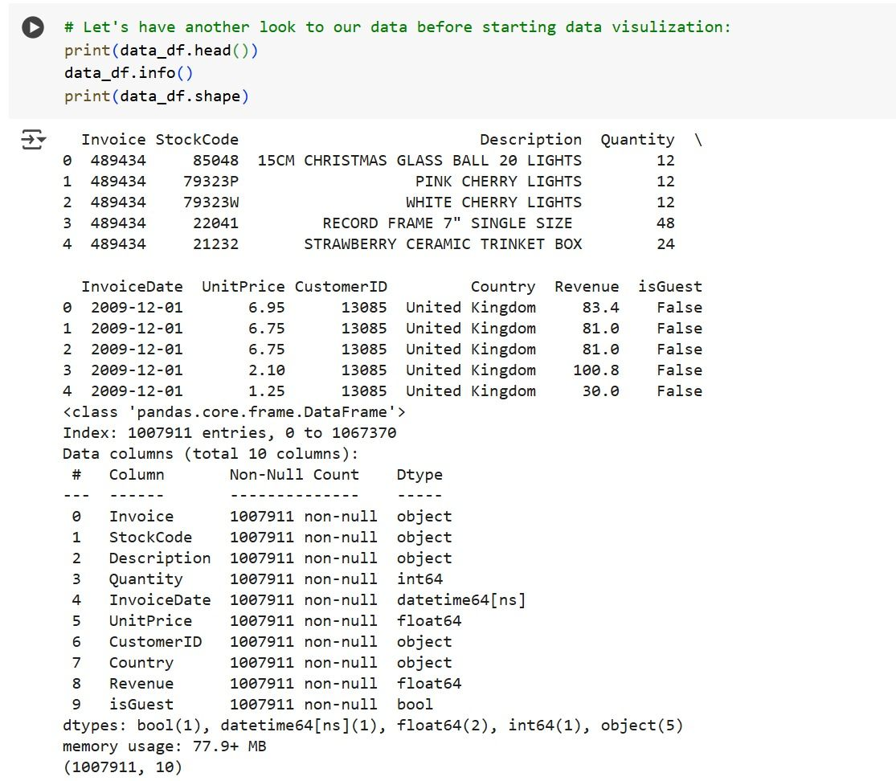
AFTER CLEANING
I

Slide 7
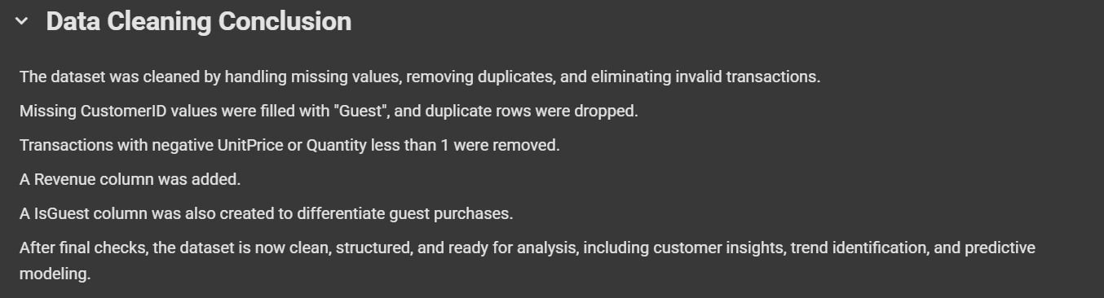
CLEANING CONCLUSION
I

Slide 8
Statistics
statistics

Slide 9
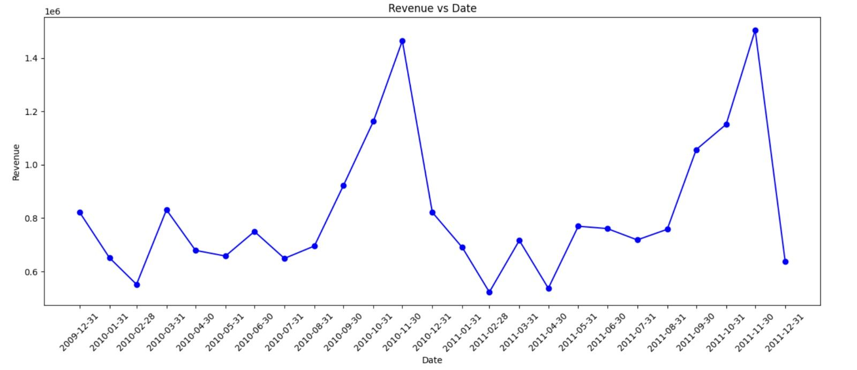
Revenue vs date
IV

Slide 10
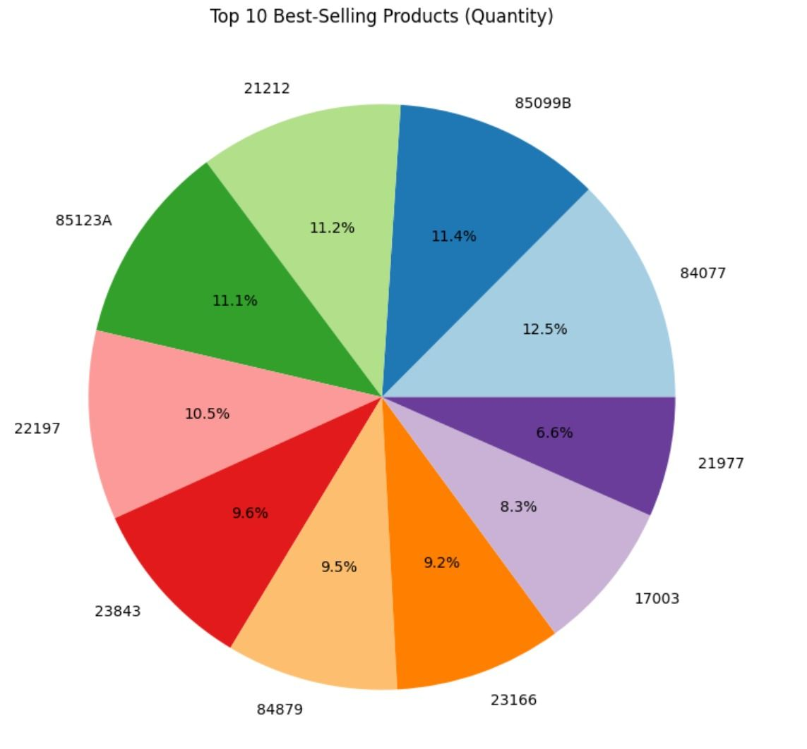
IV
Best selling products

Slide 11
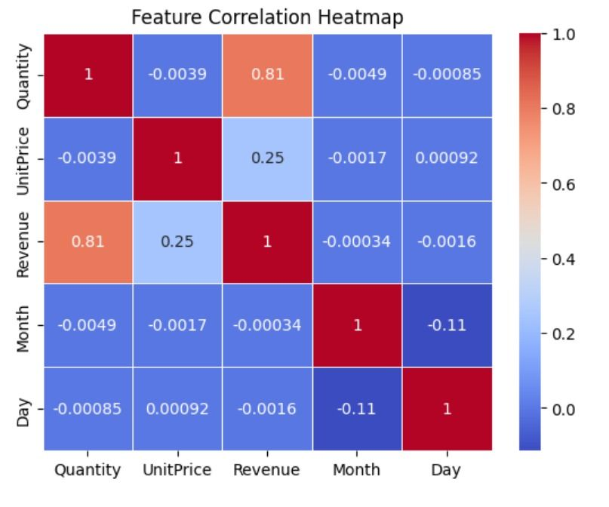
IV
Correlation heat map

Slide 12
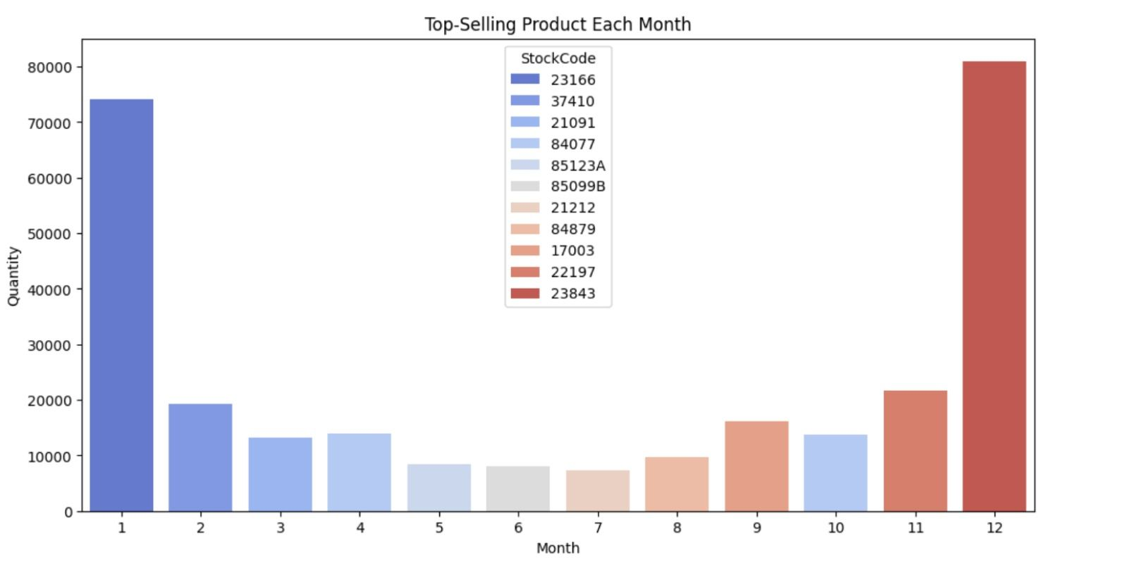
IV
Top selling products

Slide 13
Data
Modelling

Slide 14
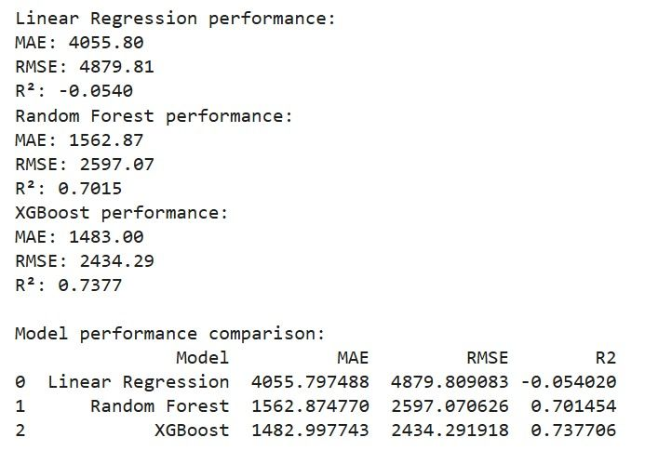
Data modelling
IV
Grouped by week & product category to get weekly revenue and avg price.
Added time features (year, month, week) + seasonal flags (summer, holidays, etc.).Included lag features (revenue from past 1–3 weeks).Capped extreme values at 90th percentile.Preprocessed: scaled numericals, one-hot encoded categories.Used TimeSeriesSplit for time-aware training/testing.

Slide 15
models
performance

Slide 16
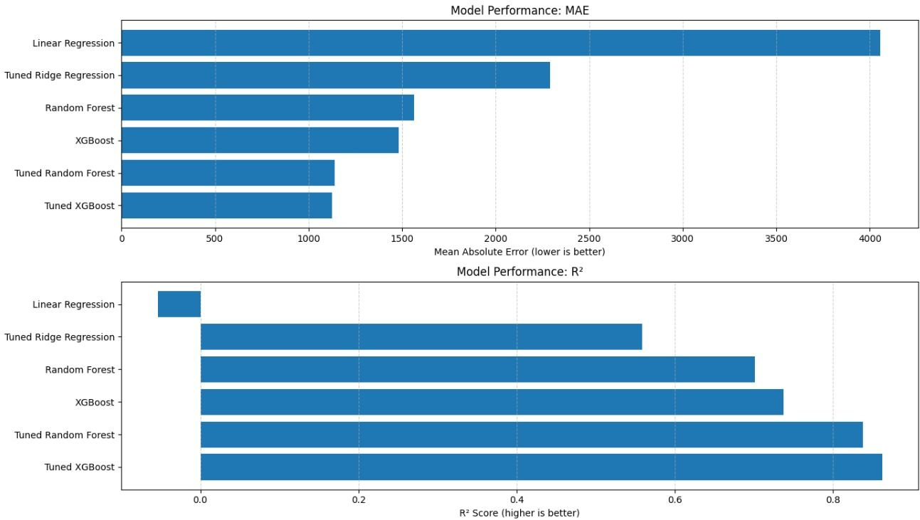
IV
Models performance

Slide 17
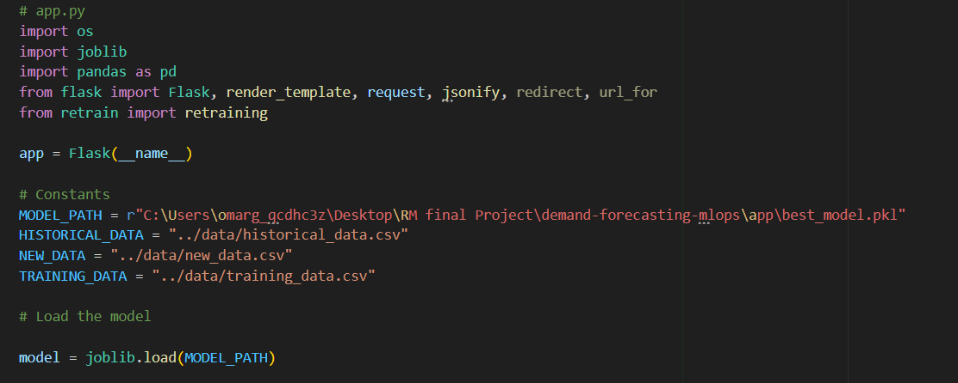
Application set up
I

Slide 18

USER INTERFACE

Slide 19
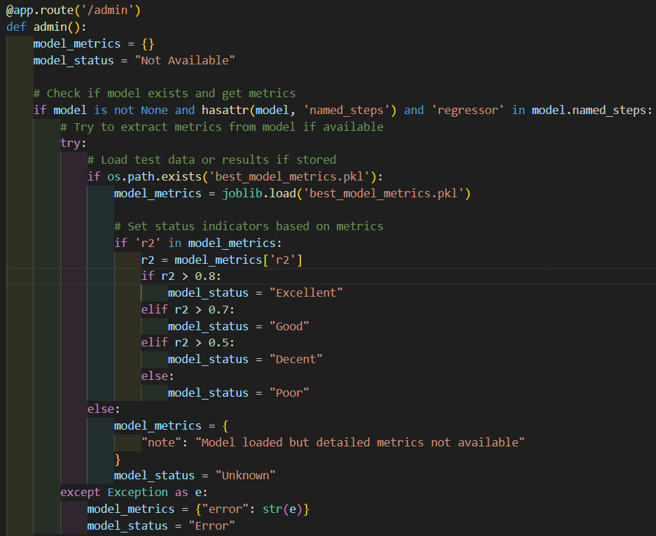
USER INTERFACE
II
Dean of Faculty of Dentistry
Pharos University in Alexandria

Slide 20
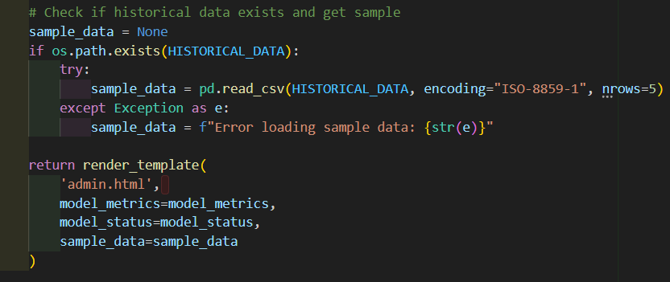
II
User interface

Slide 21


data
management

Slide 22
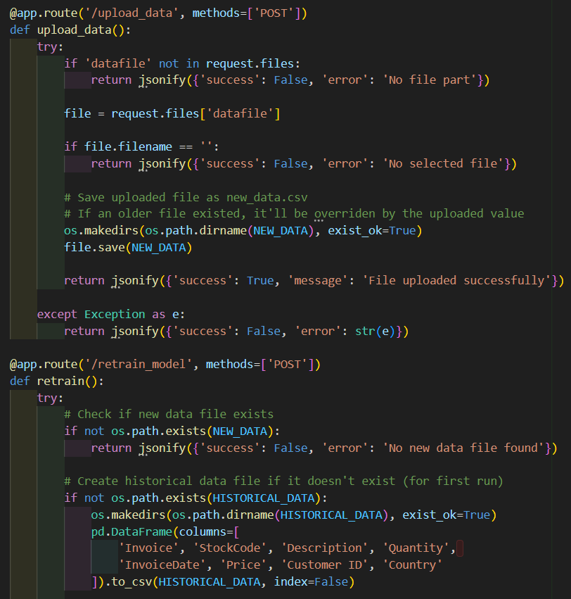
III
Data management

Slide 23
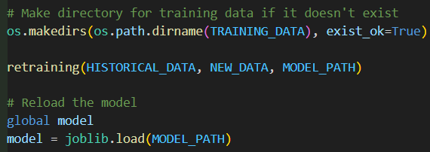
III
Data management

Slide 24

prediction
pipeline
Stay focused ?

Slide 25
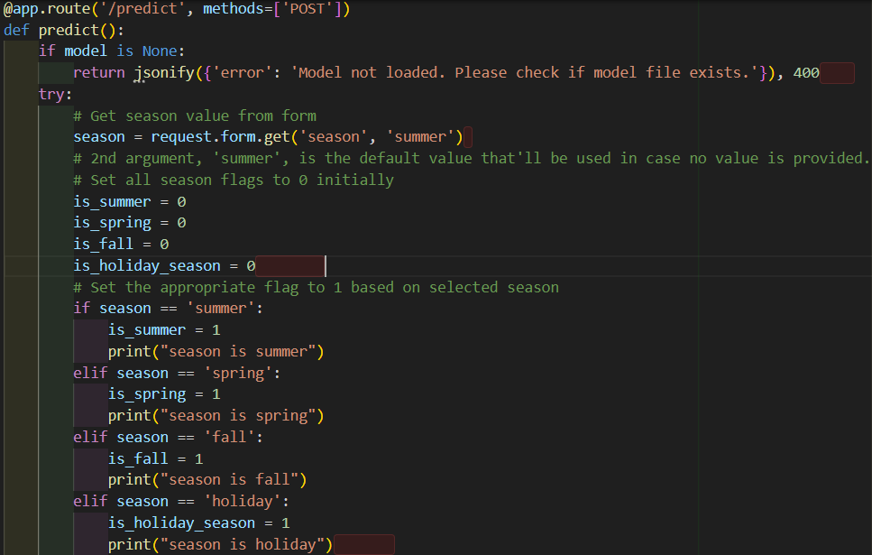
IV
prediction pipeline

Slide 26
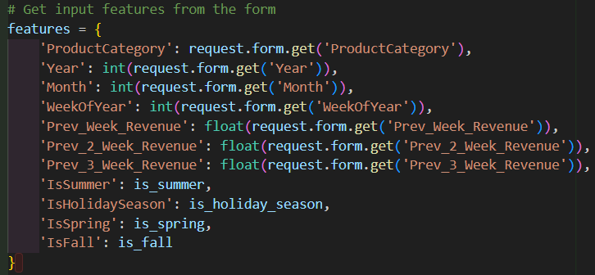
IV
prediction pipeline

Slide 27

MATERIAL AND METHODS
III
Deployment
& closing
Dean of Faculty of Dentistry
Pharos University in Alexandria

Slide 28
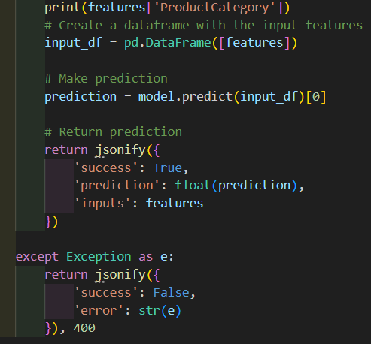
IV
Deployment & closing

Slide 29
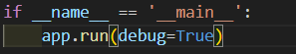
IV
Deployment & closing

Slide 30

RESULTS

Slide 31
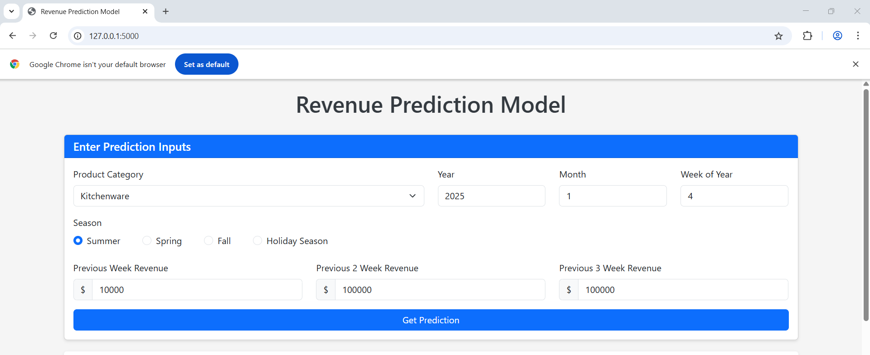
Getting prediction
IV

Slide 32
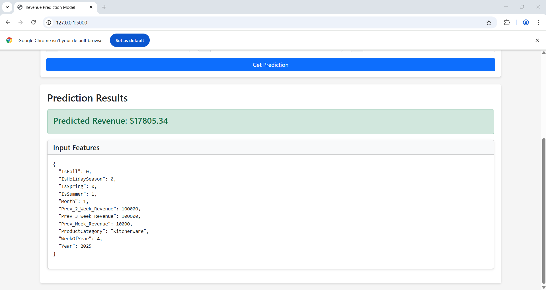
IV
Prediction results

Slide 33
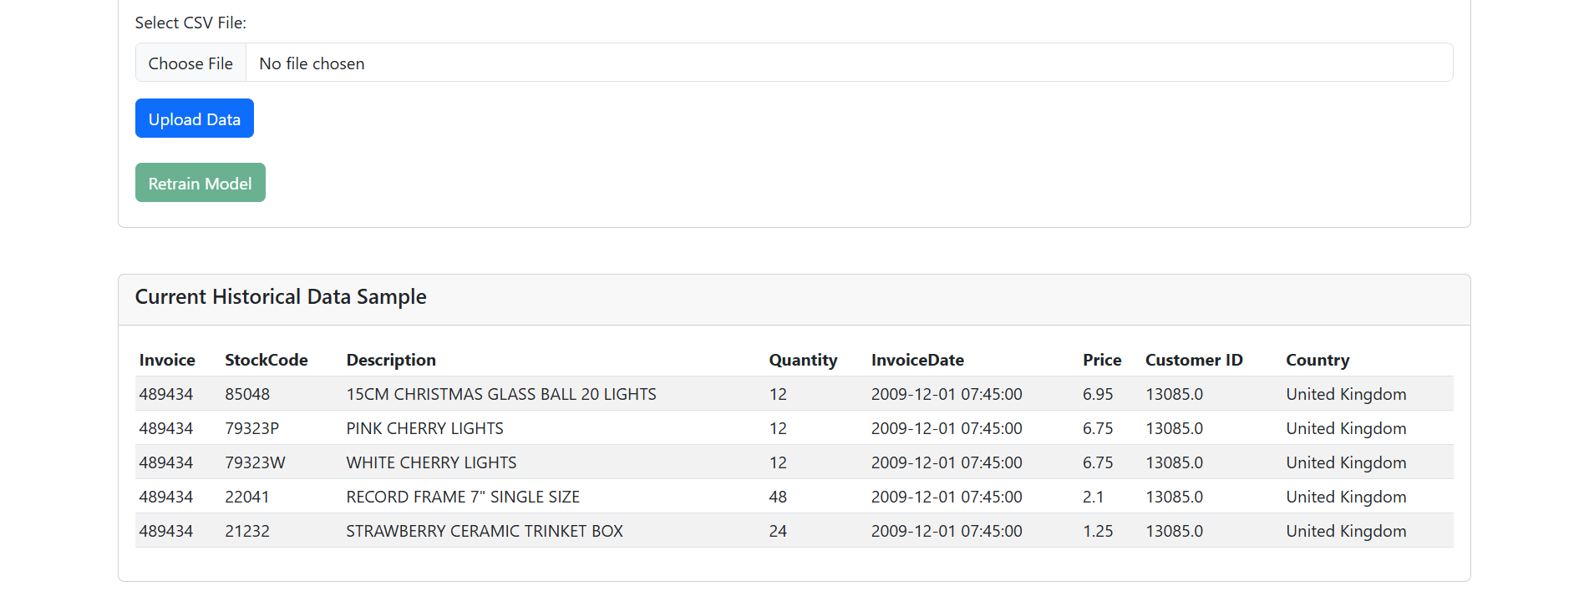
III
Retrain model results

Slide 34
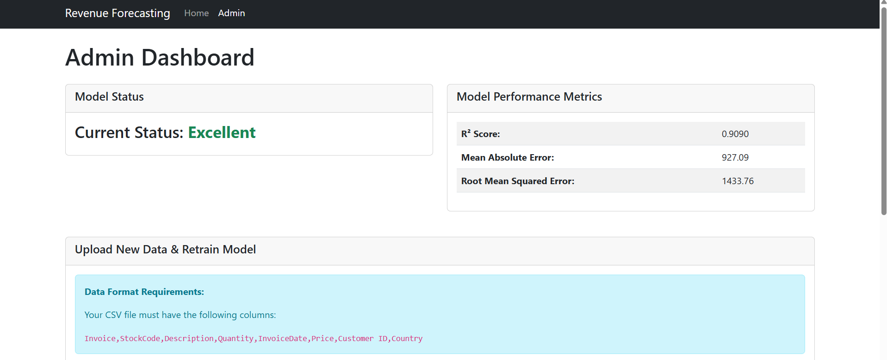
IV
Metrics & status results

Slide 35



